Slide 1

Redline Overview
Sascha Walker & Vinnan Muralikrishnan

Slide 2
Whoami
Sascha Walker
Cyber Operation w/ Minor in Digital Forensics
Likes
Hiking
Staying out of the South Dakota Cold
Whoami
Vinnan
Cyber Operation
Likes
Chess
Music

Slide 3
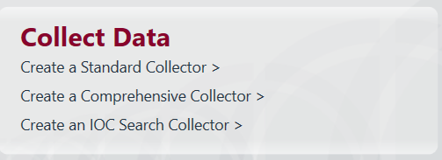
Collectors
Notes:
Different Collectors
IOC exists for Indicators of Compromise
We could not use this search as we do not have malware artifacts.
Used more for quick searching of IOCs to check if the system has malware

Slide 4
Standard Collector
Machine OS and system Details
Process Listing
Drivers
Hooks
Notes:
Machine OS and System Details
Only used on windows operating systems, as the script is a windows batch file
Process Listing
Ports processes are using / listening on
Drivers
GPU drivers
Hooks
intercepting function calls or messages or events passed between software components
Can be used by rootkits to hide themselves.

Slide 5
Comprehensive Collector
Memory
Process
Drivers
Hook
Disk
File Enumeration
Disk Enumeration
System
System Information
Registry Information
Event Logs
Network
Network Information
Browser Information
Other
Services
Tasks
Common Persistence Mechanisms
Notes:
Network
Network Information
Ports
DNS
ARP tables
Routing Tables
Browser Information
URL history
File Downloads
Cookies
Form History
Other
Common Persistence Mechanisms
File Anomalies
Version Info

Slide 6
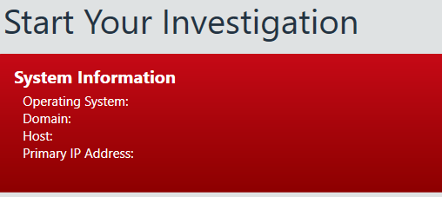
Tool Details

Slide 7
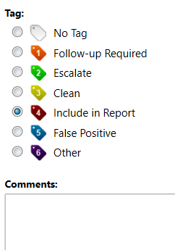
Post Collection
What did the attacker do
Look at files in high risk areas, and tag them appropriately
Look at network information
Ports
ARP tables
Routing Tables
DNS Entries
Look at tasks
Users
Event Logs
Notes:
Find files that have been modified in areas of high risk, employee information, medical records, billing, etc.
Look at network information, so we can see if anyone has connected to the network and is still connected at the time of scanning
Event logs can list if any firewall rules have been changed from the attacker to let them get a backdoor in
The attacker might add a user for persistence
Looking at the tasks you will be able to see if the attacker has created any persistence that calls back at set times.

Slide 8
Post Collection
Cont..
How did the Attacker get in
Network Traffic
Websites
Redirects
One time Visits
Hidden Visits
Forms
Can export the lists to compare before and after attacks
Notes:
We could look at the networking information to see if the attacker is still on the system and on what port and ip address they are coming from. The port can tell us how they got in, SMB, reverse HTTPS, the address can tell us if they were just hopping around our network or not.
The more reliable way we can get information on how an attacker got in is by the website information category.
We can see redirects, One time Visits, Hidden Visits, and Forms.
Redirects are where a website will redirect you to a page if you mistyped something or if you click on a menu bar item to bring you to a different page.
One time Visits are websites you only visit once, malware will do this to download more malware on the system.
Hidden Visits are where you are redirected to websites, usually authentication servers, and the user does not see the url change or the page either until the login is verified.
Form are just form information, usually just login forms, any saved information from the user from their websites.

Slide 9
Comparisons
Notes:
We’ll be comparing Redline’s pros and cons, and then comparing it to FTK.

Slide 10
Redline Pros
Network Traffic
Process information
Fast and intuitive search mechanism
Tagging system is intuitive
Clean Interface, sleek and modern
Short load times of analysis files
Scripting with other tools
Notes:
Can see the process information, and where the process is saved on the disk
Search mechanism is fast, you can repeatedly press enter to move onto the next item found.
The short load times are great for fast analysis
You are able to script this tool with other tools, you are also able to export the lists of what you have
Like networking or file system information to compare before and after the system has been attacked.
This method is hardly an option for practical day to day use, more of a monthly or bi-weekly scan, purely due to the amount of time a scan takes on a system.

Slide 11
Redline Cons
No input telling you progress time on tool collection
Can not see deleted files
Can not see the attacker moving in the filesystem
You can see the drives connected, but not the files in them
Analysis machine will need a lot of memory available for bigger analysis files
Can not see file contents of the system

Slide 12
FTK vs Redline Differences
FTK
Has Data recovery options
Is multi-platform
Works for mobile devices except for few
Used extensively in law enforcement
Takes comparatively lesser time to install
REDLINE
Does not have data recovery options
Isn’t multi-platformed
Does not work for mobile devices
Is a poor man’s malware forensic utility
Takes comparatively longer time to install

Slide 13
FTK vs Redline Similarities
Both are used to analyse a compromised windows operating system
Both FTK and Redline imager is free to download
Both are very good for looking into network traffic
Both lists all the drivers for the computer
Both Analyze and view imported audit data.

Slide 14
Summary
Redline is a great tool for a specific subset of looking for malware.
The tool is great for looking at network traffic and seeing the currently running processes
Lacking in seeing contents of files
FTK is a better tool for seeing file information on a system
Redline is a tool that is designed to be used with others.
Redline can highlight files changed for another user to look at in FTK or another forensic tool.
Redline is the first tool ran in a forensics case.
Notes:
Redline is a tool that is well suited to work with other tools.
The reporting mechanisms of Redline are much easier to read than an FTK report, so this tool is used more to highlight the specific files you will need to look at in FTK to see what the attacker modified
Redline is a good tool to run first on a forensics case as that can give you a more efficient workflow, as you can just highlight the files that have been modified and then check them out in FTK or another tool to see if they have been.

